Slide 1



CREDIT CARD FRAUD DETECTION
Identifying fraudulent transections

Slide 2
GROUP-13
01
02
03
04
05
DISHA
NIVEDITA
HARSH DUBEY
NIKHIL
HARSHIT

Slide 3

Overview
Credit card fraud causes billions in financial losses annually.
01
Understanding the Challenge
Detecting fraudulent transactions is difficult due to:
02
03
imbalanced datasets
Evolving fraud tactics
Need for real-time detection
Problem: How can we accurately and efficiently detect fraudulent credit card transactions using data-driven techniques?
04

Slide 4






Introduction
Fraud detection prevents losses, builds trust, ensures compliance and stops criminals early.
Why Fraud Detection Matters
Rise in online payments has led to increased vulnerabilities.
Fraudulent transactions can affect both customers and financial institutions.
Traditional rule-based systems are insufficient — hence, the need for intelligent models.
Arowwai Industries
Goal:
Use machine learning to build a predictive model that can classify transactions as fraudulent or legitimate.

Slide 5

4
Evaluation Techniques:
Confusion Matrix
Correlation Matrix Heatmap
Pie Chart
3
Why Isolation Forest?
Effective for rare event detection like fraud
Scales well to large datasets
Simple and fast to train
METHODOLOGY
2
Model Used:
Isolation Forest
1
Dataset
Kaggle dataset of credit card fraud detection

Slide 6
Output/Result

Slide 7


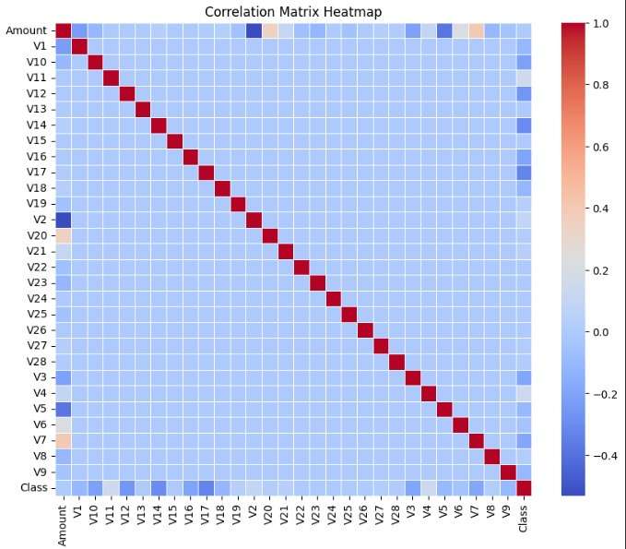
HEAT MAP

Slide 8
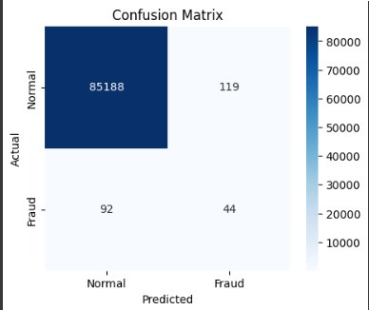
----------------------------------------------------------------------------------------------------------------------------
CONFUSION MATRIX

Slide 9
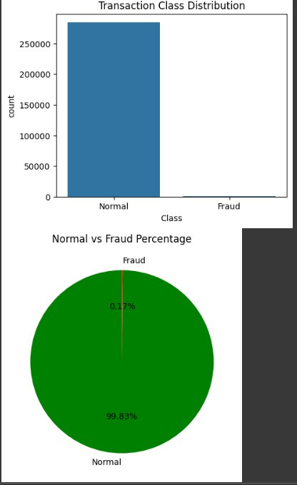
Pie Chart

Slide 10
BAR GRAPH

Slide 11




Accuracy
The model works well for the given in put of the amount and the transactions.
99%

Slide 12
THANK YOU

